Slide 1



Resource Management: Optimizing for Efficiency
Resource management is the process of planning, organizing, and controlling the use of resources to achieve organizational goals.

Slide 2



Elastic Cloud Balancing
1
Dynamic Scaling
Adjusts computing resources based on real-time demand.
2
Cost Optimization
Reduces unnecessary spending by allocating resources efficiently.
3
High Availability
Ensures continuous service by distributing workload across multiple servers.
4
Performance Improvement
Reduces latency and improves response times by managing server load.

Slide 3


Job Shop Scheduling
1
Job Arrival
New tasks or jobs are received and added to the queue.
2
Machine Allocation
Jobs are assigned to appropriate machines based on their requirements.
3
Job Completion
Finished jobs are removed from the schedule, freeing up resources.
4
Resource Management
Monitors resource utilization and optimizes allocation based on available capacity.

Slide 4


Pseudo Code for Elastic Cloud Balancing
function elasticCloudBalancing(demand):
if demand > currentCapacity:
scaleUp(demand - currentCapacity)
elif demand < currentCapacity:
scaleDown(currentCapacity - demand)
else:
maintainCurrentCapacity()
end function

Slide 5

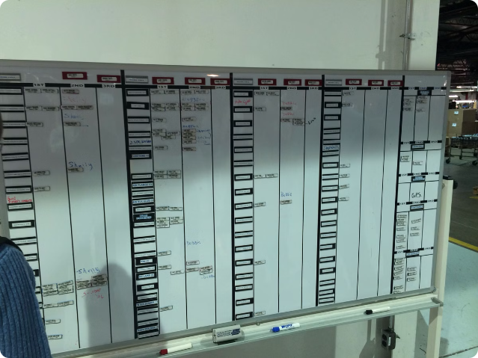
Pseudo Code for Job Shop Scheduling
function jobShopScheduling(jobs, machines):
for each job in jobs:
find suitable machine for job
allocate job to machine
update machine schedule
end for
optimize machine schedules
return optimized schedule
end function

Slide 6
Advantages of Integrated Resource Management
Increased Efficiency
Cost Reduction
Improved Decision-Making
Resource optimization helps reduce unnecessary spending and maximize return on investment.
By managing resources effectively, businesses can streamline processes, reduce waste, and improve productivity.
Accurate data on resource availability and usage empowers better informed decisions.

Slide 7


Challenges and Considerations
Resource Availability
Ensuring sufficient resources are available to meet demands.
Resource Utilization
Tracking and optimizing resource usage to minimize waste and maximize efficiency.
Resource Allocation
Assigning resources to projects or tasks based on priorities and requirements.

Slide 8


Conclusion and Key Takeaways
Effective resource management is crucial for organizational success. By leveraging tools like elastic cloud balancing and job shop scheduling, businesses can optimize resource utilization, improve efficiency, and gain a competitive edge.

